Slide 1
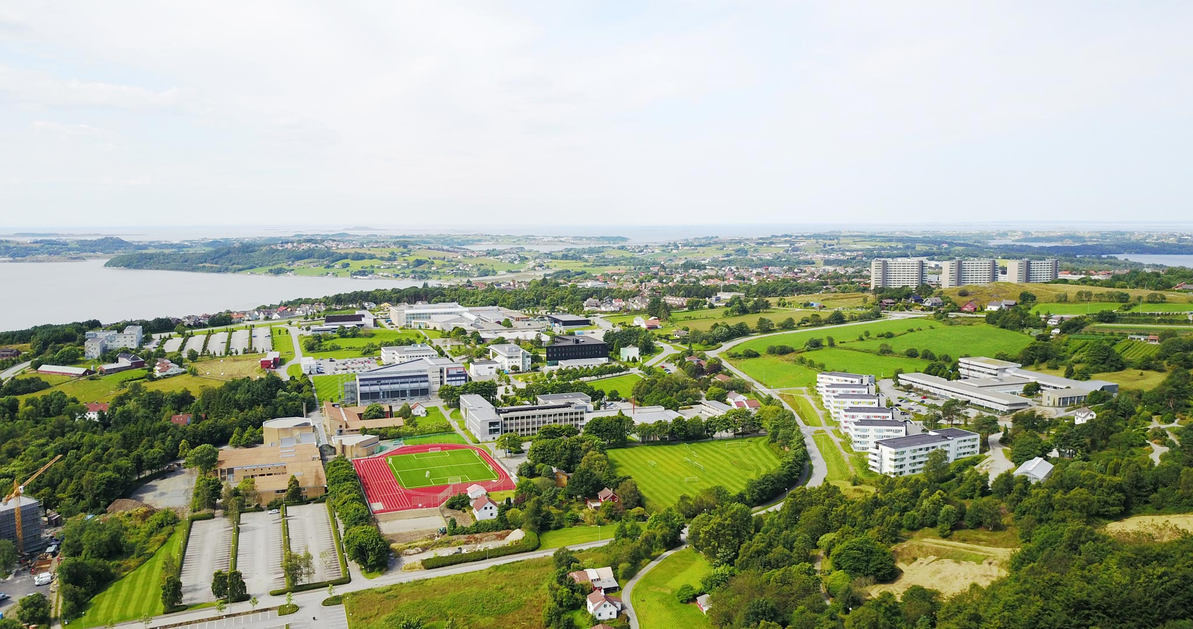
ESREL SRA – E 2025
Welcome to Stavanger, Norway!
15th – 19th June 2025
esrel2025.com

Slide 2
35th ESREL conference
33rd SRA-E conference

Slide 3
The scope of the conference
Risk, safety, security, reliability, resilience, vulnerability and sustainability assessment, perception, communication, management and governance, both theory and application
Theme of the conference: Advancing risk, safety and reliability sciences, with applications – from component, to system, to society

Slide 4
Submissions
Abstracts
Papers
EasyChair with papers published in an open access indexed Proceedings by Research Publishing Services.

Slide 5
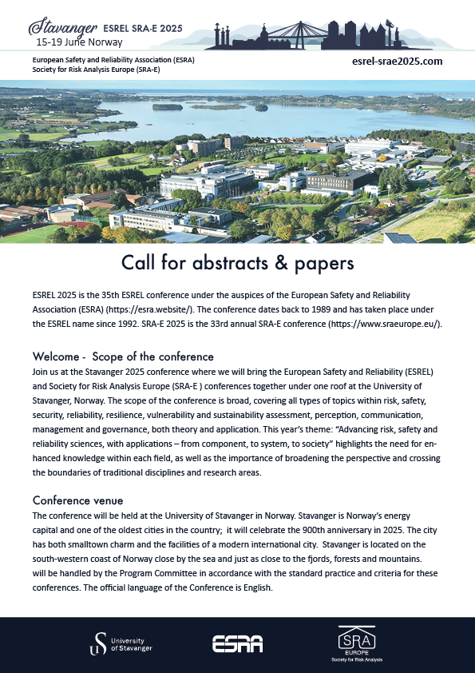
1 October 2024
Abstracts for Presentations & Papers
1 October 2024
Suggestions, Abstracts for Special Sessions, Roundtables
1 November 2024
Notification of Abstracts, Special Sessions, Roundtables
15 January 2025
Full Paper Submission
15 March 2025
Final Revised Papers
esrel2025.com

Slide 6
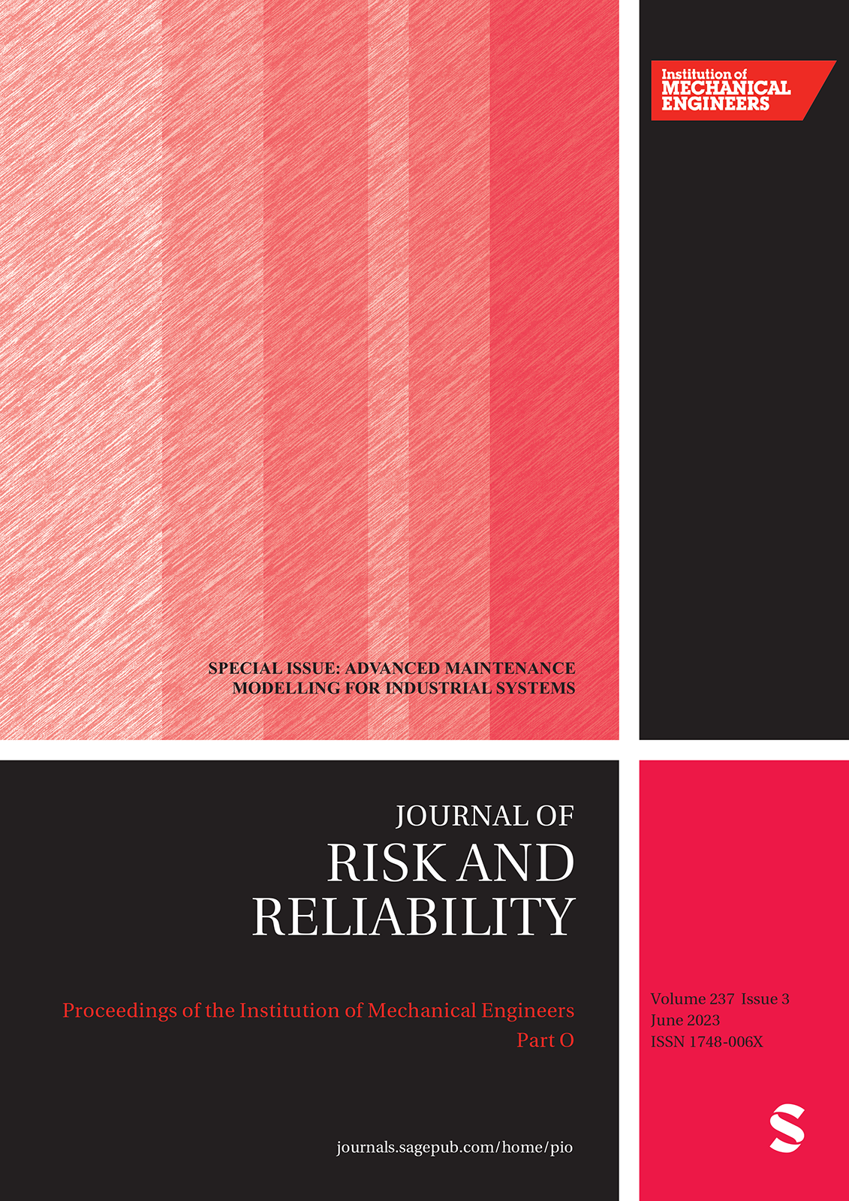
Special issues (to be confirmed)

Slide 7
Organizing committees
General Chairs:
Prof. Terje Aven, University of Stavanger (UiS), Norway
Associate Prof. Marja Ylönen, UiS
General Co-Chairs:
Prof. Michael Beer, Leibniz Universität Hannover, Germany, University of Liverpool, UK/Tongji University, China
Prof. Myriam Merad, CNRS, France
Prof. Enrico Zio, Mines Paris-PSL University, France and Politecnico di Milano, Italy
Technical Program Committee Chairs: Professors Eirik B. Abrahamsen, Roger Flage and Frederic Bouder, UiS
Scientific Programme Committee
Local Programme Committee
University of Stavanger: A center on education and research on risk, safety and reliability with a staff of about 25 professors, 20 Post Docs/PhDs and 100 master students a year

Slide 8
Nice hostel
Solborg
55 Euros
Top hotels
about 175 Euros

Slide 9
Conference fees
Members 500 euros
Students 300 euros

Slide 10
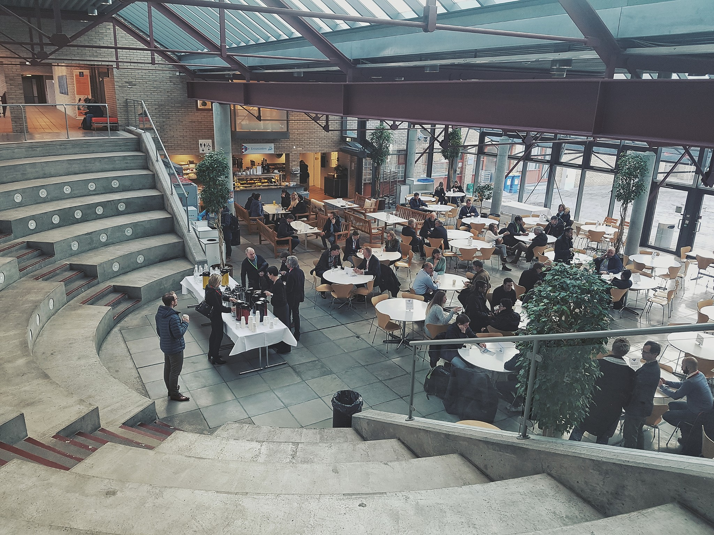
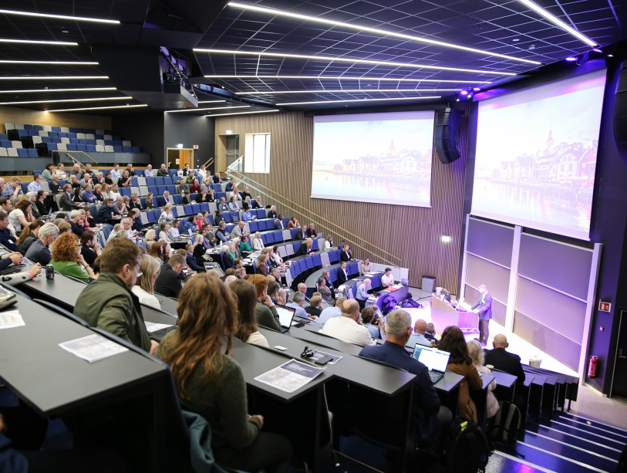
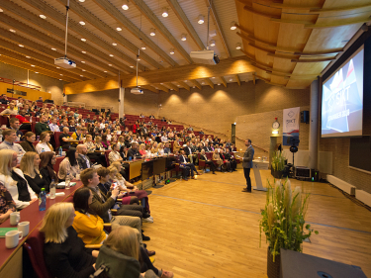
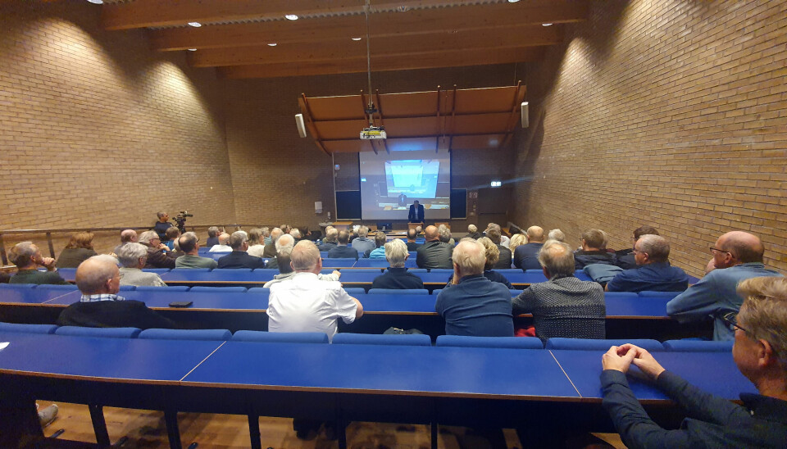
Notes:
650 seats

Slide 11
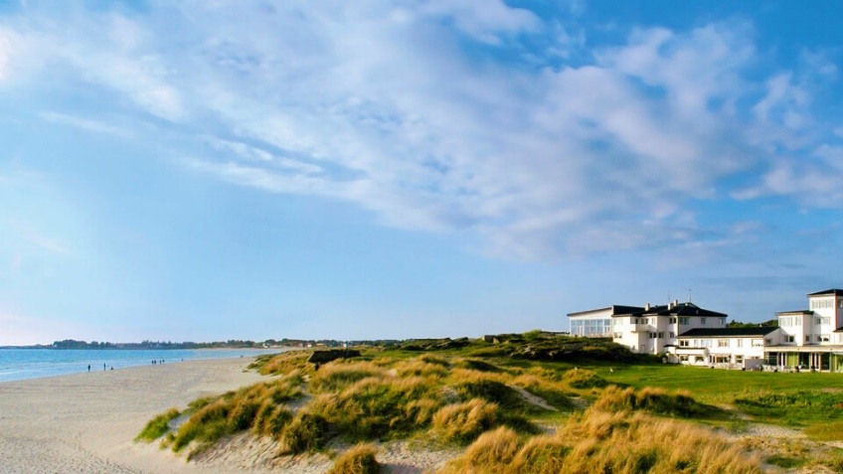
Social Program
Conference dinner
at Sola Beach Hotel
Conference dinner
Wednesday 18.30-23.30
Includes: 3-course dinner, 3 units wine/beer, entertainment
Notes:
We aim for a fun and memorable social program, including Poster party, Exhibition party, congress dinner and pre and post tours. The Poster Party and Exhibition Party will be at Stavanger Forum.
There are several great alternatives for the congress dinner, both on-site and down-town. We would like to host the congress dinner at the Stavanger Concert Hall. This is an attractive landmark and the main
cultural arena in Stavanger With it’s Scandinavian design seaside location, offering great views of mountains and fjords, the Stavanger Concert hall would be the ideal location for the EUROCORR 2024 Congress dinner.

Slide 12
Stavanger 900 years
Notes:
Spouses program: National Geographic Traveller recently ranked Norwegian fjords as the number one travelling destination in the world. The Lyse fjord near Stavanger is one of the most spectacular fjords in Norway. All Norwegian fjords are different in character, but with the surrounding mountains plunging straight into the fjord, the Lysefjorden is a unique and breathtaking experience. Much of the 45 km long fjord passes between towering cliffs and mountains. The most famous of these is the Pulpit Rock or Preikestolen in Norwegian. Pulpit Rock is one of the areas most visited tourist attractions. This natural rock formation with a 25 meter squared plateau stands 604 meters above the sea. Thousands of tourists visit the Rock every year. The trip takes about two hours by foot, but the rock formation can also be enjoyed from the fjord by boat.
A lot of cultural events take place in Stavanger during the summer months. Among those we have international music festivals, a humor festival and a food festival. Stavanger also host the World Tour Beach Volleyball.
Forslag til fokus: Byen, trehusbyen, festivalene. NB! World Tour i strandvolley foregår parallelt med konferansen! “HUMOR”: For å gi et best mulig tilbud for ledsagere, har vi tatt på oss å arrangere Beach Volley World Tour under konferansen!!!

Slide 13
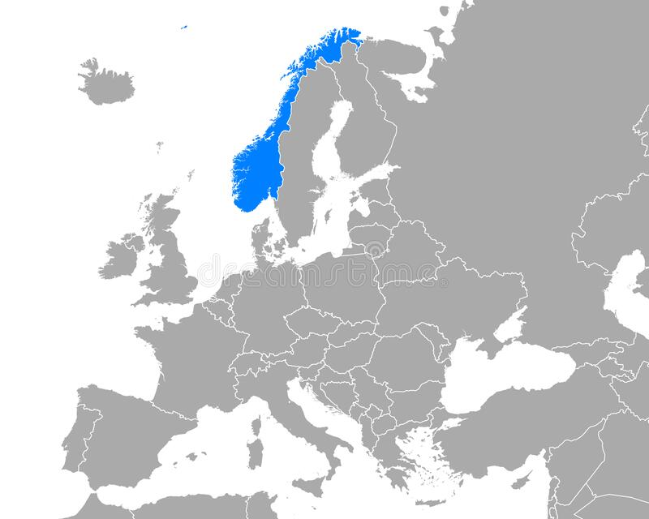

Slide 14
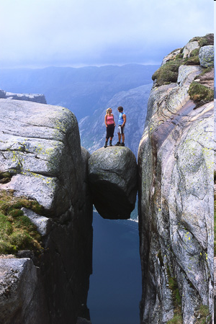
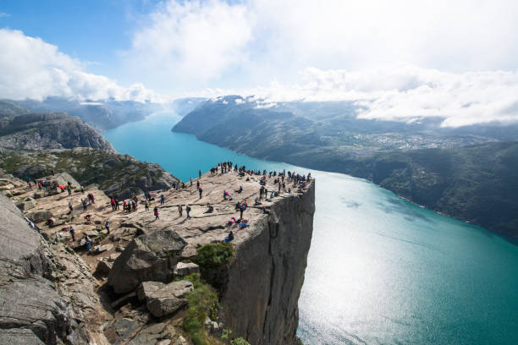

Slide 15
ESREL SRA – E 2025
Welcome to Stavanger, Norway!
15th – 19th June 2025
esrel2025.com

